Slide 1
“Business integration trips in the Silesian region” Applied Data Science Capstone Project
Katarzyna Hejczyk-Mika

Slide 2
Business idea
Full package of a business trip offering in the Silesian region
Offer
To offer an interesting business trip with entertainment opportunities
Aim
Business owners or tourist companies
Target stakeholders
Relaxing surrounding, entertainment, hotel with conference facilities
Requirements
Professionals, age 20+
Target audience

Slide 3
Tools
Foursquare API - search for natural surrounding (e.g. lake, mountains), entertainment for employees (e.g. bowling) and hotels with conference facilities
https://developer.foursquare.com/docs/
Github – to share the project
https://github.com/
IBM Watson Studio – to import all libraries and run codes
https://dataplatform.cloud.ibm.com/
NYU Spatial Data Repository website – search for location coordinates of selected cities
https://geo.nyu.edu/catalog/stanford-xh662zc5620

Slide 4

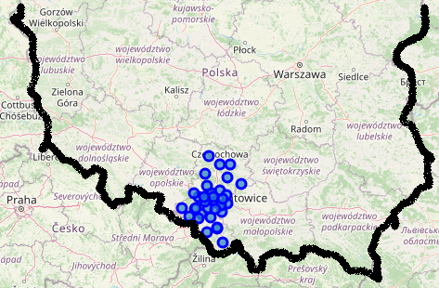
Maps of Poland and Silesian’s neighborhoods
Map of Poland generated from repository json file
Cleaned data representing Silesian’s neighborhoods

Slide 5
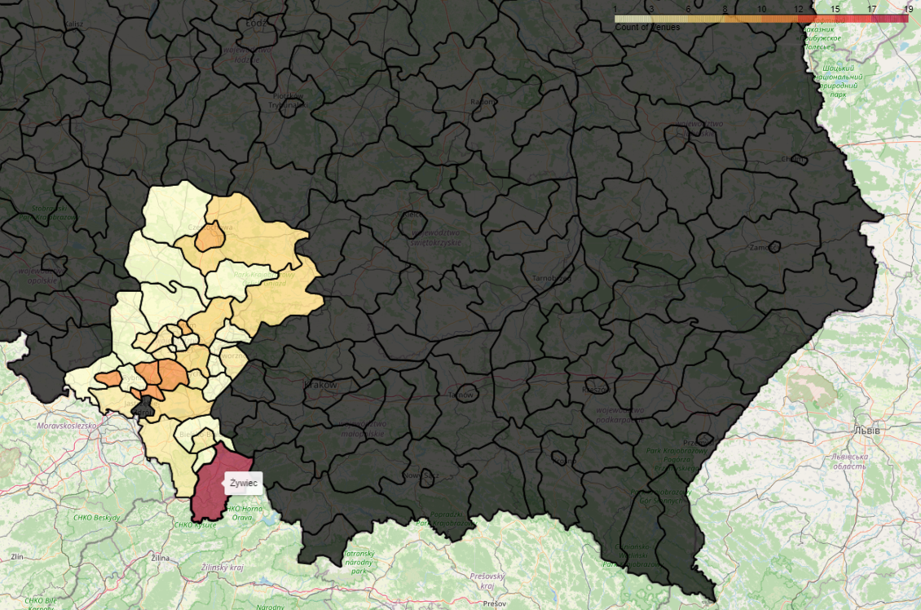
Distribution of venues in Silesian’s neighborhoods
168 recommended venues (belonging to 25 unique categories) of interest were found in all Silesia’s neighborhoods.
The area highlighted in red shows the largest number of venues (Zywiec), whereas the light yellow neighborhoods - the smallest number of recommended venues. Grey – no venues of interest.

Slide 6
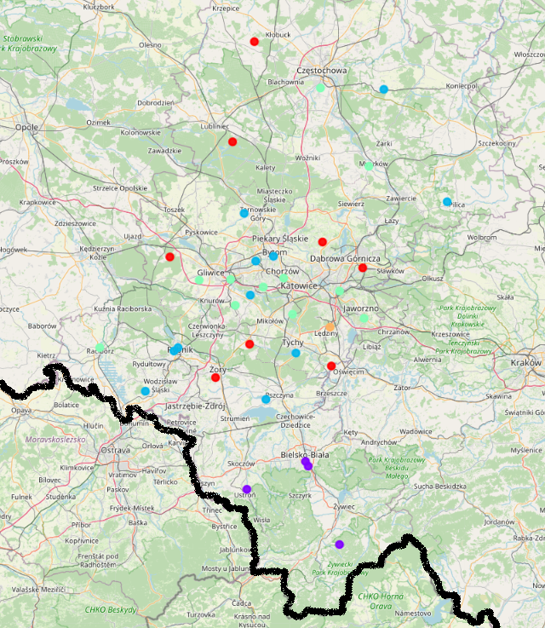
Clustered neighborhoods
Silesian’s neighborhoods grouped into 5 clusters.
Purple cluster – highly valued:
location surrounding: mountains and trail
entertainment: diving, go kart, golf course
Blue cluster - highly valued:
location surrounding: lake, forest
entertainment: bowling, diving
Green cluster - highly valued:
locations surrounding: various, not consistent
entertainment venues: bowling
Red cluster - highly valued:
locations surrounding: lake and natural preserve
entertainment: go kart, paintball
Orange cluster - highly valued:
locations surrounding: scenic lookout, trail
Entertainment: go card and golf course

Slide 7
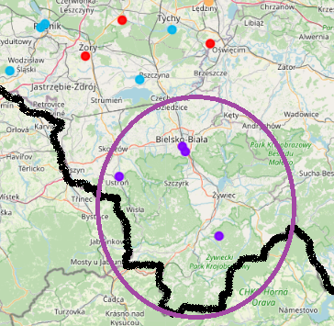
Discussion
Analysis of venues show that the southernmost area of Poland (Zywiec Neighborgood) has the largest number of recommended venues of interest.
Clustering analysis confirms that the same neighborhood has location surrounding that the client values high and entertainment opportunities matching client’s requirements

Slide 8
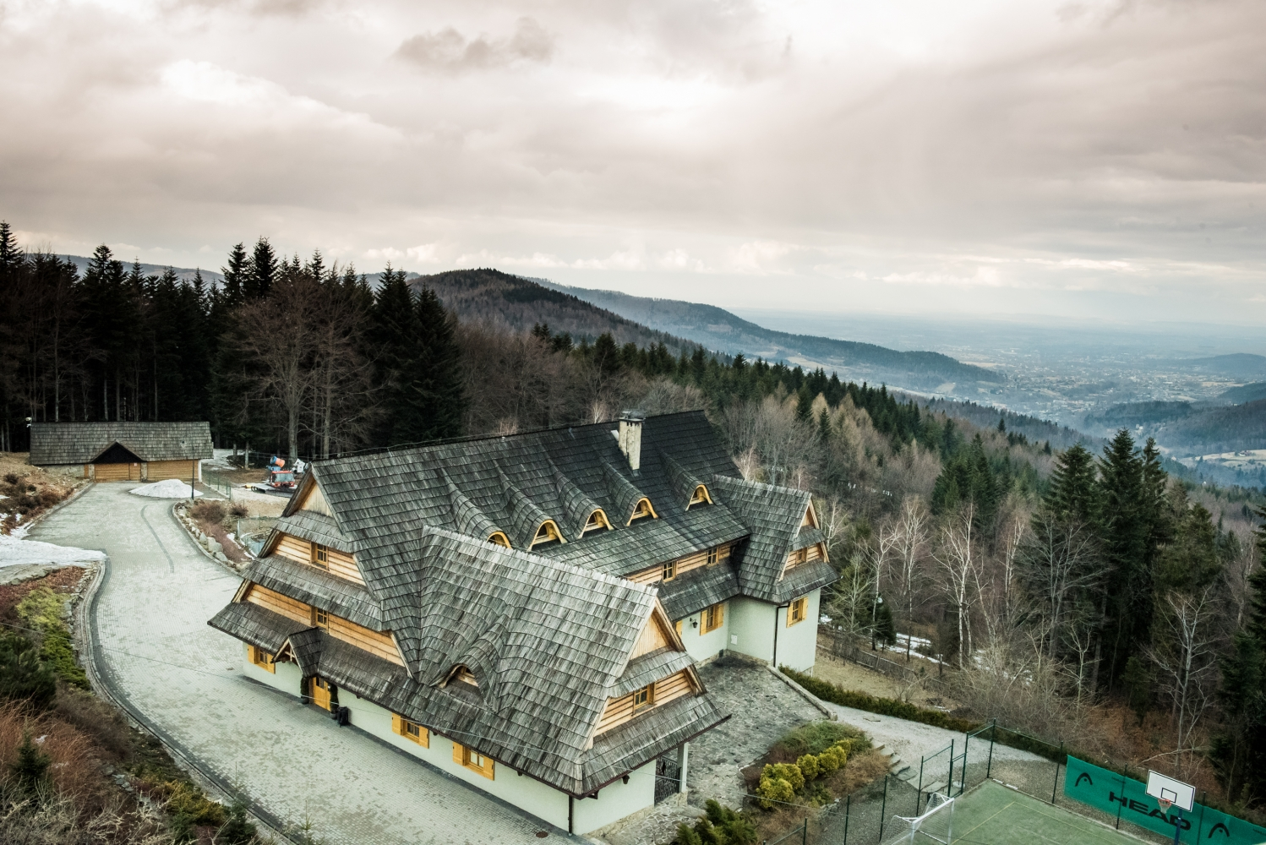
Discussion
Further analysis of Zywiec neighborhood shows some high valued hotels with conference facilities.
Based on customer’s rating and opinions Kocierz Hotel & SPA was chosen as a recommended place for an integration trip.
The venues within 500m from the hotel were investigated in addition to previously found venues for this region.
https://kocierz.pl/galeria-kocierz-hotel-spa

Slide 9
Conclusions
Companies often choose locations outside their offices to have business meetings, trainings and conferences with the aim to integrate employees.
Tools like Foursquare can help decision makers to choose the right spot for they business venues. In this work I show the process, tools and methods that can be used to design an integration trip offering.

